Slide 1


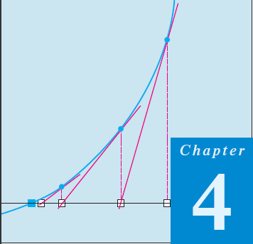
Thomas Calculus 11th
05
Application Of Differentiation
Samuel Lukas

Slide 2
Agenda
Rates Equations
Extreme Values of Functions
Increasing and Decreasing Functions
Concavity and Curve Sketching
Applied Optimization Problems
L’Hopital’s Rules

Slide 3
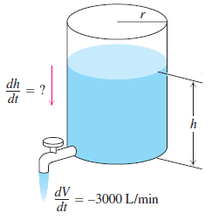




Rate Equations
How rapidly will the fluid level inside a vertical cylindrical tank drop if we pump the fluid out at the rate of 3000 L min?

Slide 4

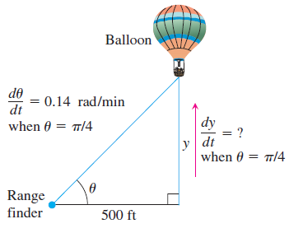




Example 1

Slide 5

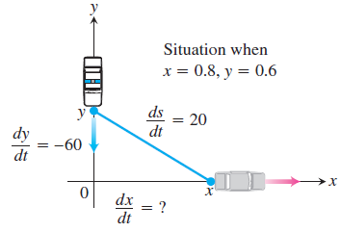




Example 2

Slide 6

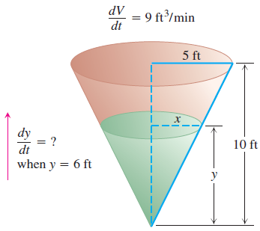






Example 3

Slide 7

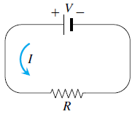

Exercise 1

Slide 8
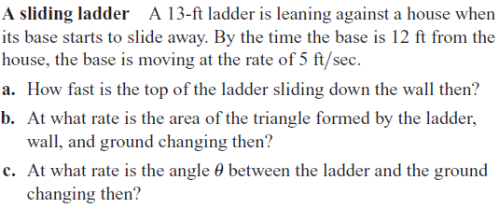
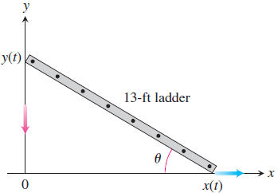
Exercise 2

Slide 9

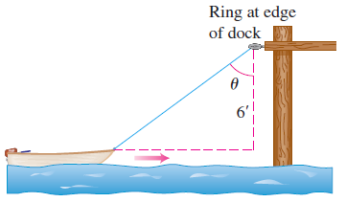
Exercise 3

Slide 10

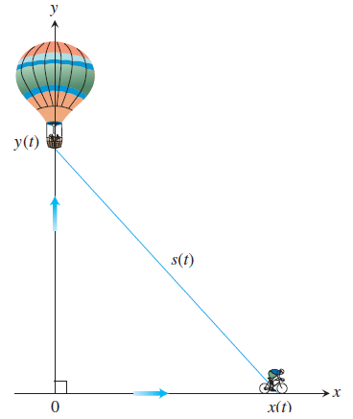
Exercise 4

Slide 11

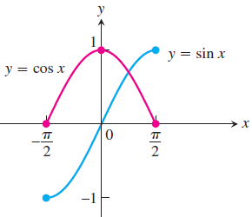
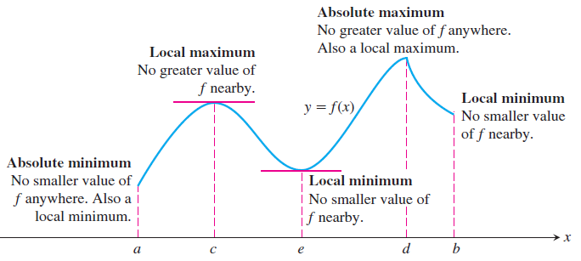
Extreme Values of Functions

Slide 12
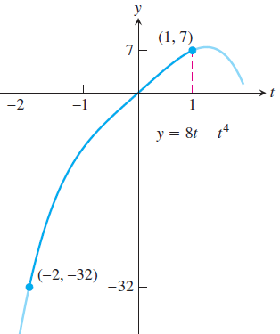


Example 4

Slide 13

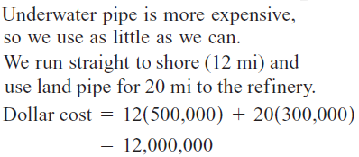

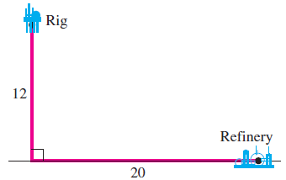
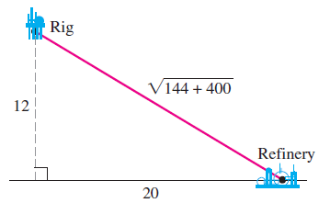
Example 5

Slide 14
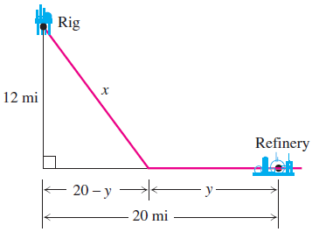




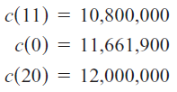

Slide 15

Exercises 5
In Exercises 1-4, match the table with a graph.
Find the derivative at each critical point and determine the local extreme values.

Slide 16

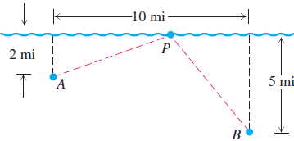
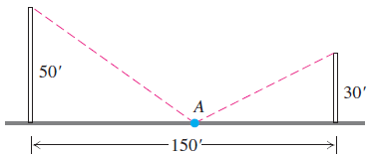



Slide 17

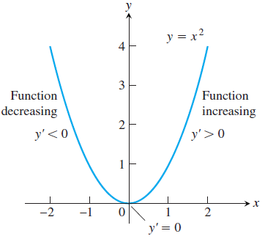


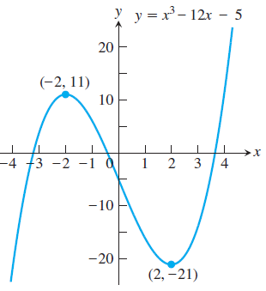

Increasing Functions and Decreasing Functions

Slide 18

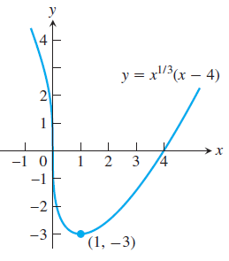

First Derivative Test for Local Extrema

Slide 19

Exercises 6
In Exercises 1–28: Find the intervals on which the function is increasing and decreasing.
Then identify the function’s local extreme values, if any, saying where they are taken on.
Which, if any, of the extreme values are absolute? Support your findings with a graphing calculator or computer grapher.

